Slide 1
Analyzing packets to demonstrate the vulnerability of LoRaWAN
Team 454P
Seokhyeon Bang
Junyoung Jang
Doyong Kwon
Yuseon Choi
Minju Ro
Jerry Lee
2022 K-SW square mid-presentation

Slide 2

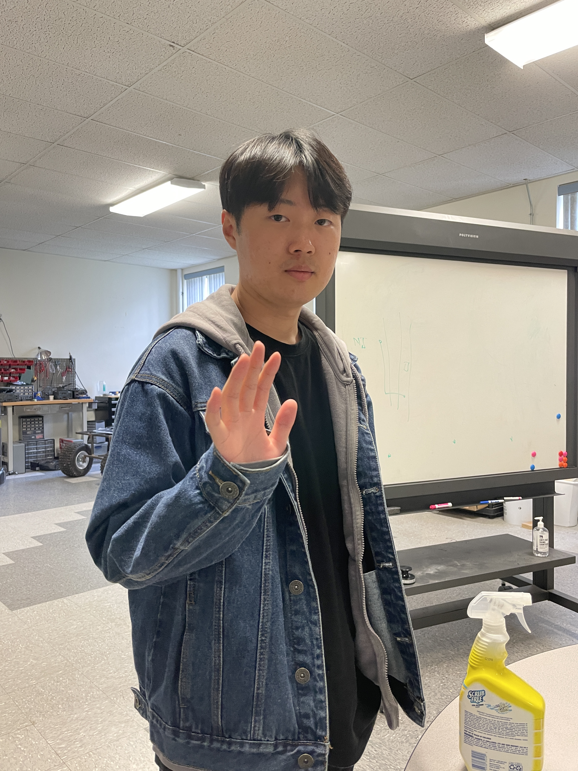




Team Members (454P)
Seokhyeon Bang (Team Leader)
Chung-Ang University
kzrt0123@cau.ac.kr
Doyong Kwon
Kyungpook National University
doyong365@knu.ac.kr
Junyoung Jang
Chung-Ang University
junjang99@cau.ac.kr
Minju Ro
Chung-Ang University
romj98@cau.ac.kr
Yuseon Choi
Chonnam National University
181133@jnu.ac.kr
Jerry Lee
Purdue University
lee3245@purdue.edu

Slide 3
Contents
1. Background
What is LoRa? / What is LoRaWAN?
Advantages of LoRa
Use Cases of LoRa
2. Introduction
Security issues of LoRaWAN
Goal of 454P
3. Progress
Constructing Local LoRaWAN
Methodology – Jamming
Methodology – Packet Sniffing
4. Project Milestones

Slide 4

Background

Slide 5
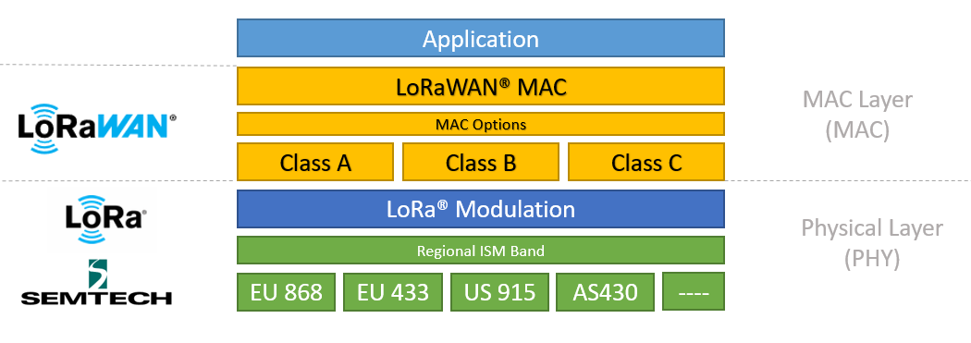
Background
What is LoRa?
Low-Powered Wide Area Network(LPWAN) technology that enables low-power, long-distance data transmission
What is LoRaWAN?
Open networking protocol on top of LoRa
The architecture of LoRa and LoRaWAN

Slide 6
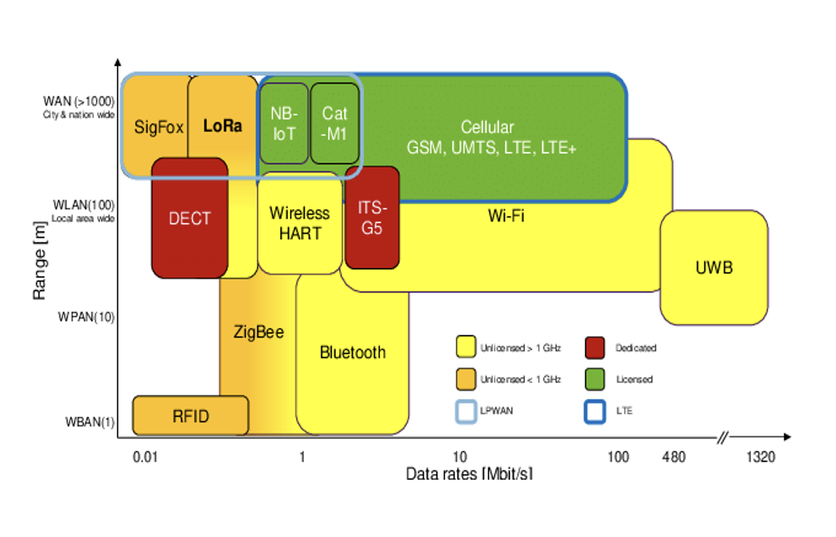
Background
Advantages of LoRa
bi-directional communication, localization, and mobility of services
LoRa vs Wireless communications
Transmit small data to remote areas
Cover a wider area than others (Wi-Fi, Blutetooth, ZigBee)
Easy to build and maintain private networks
Comparison between wireless communications

Slide 7
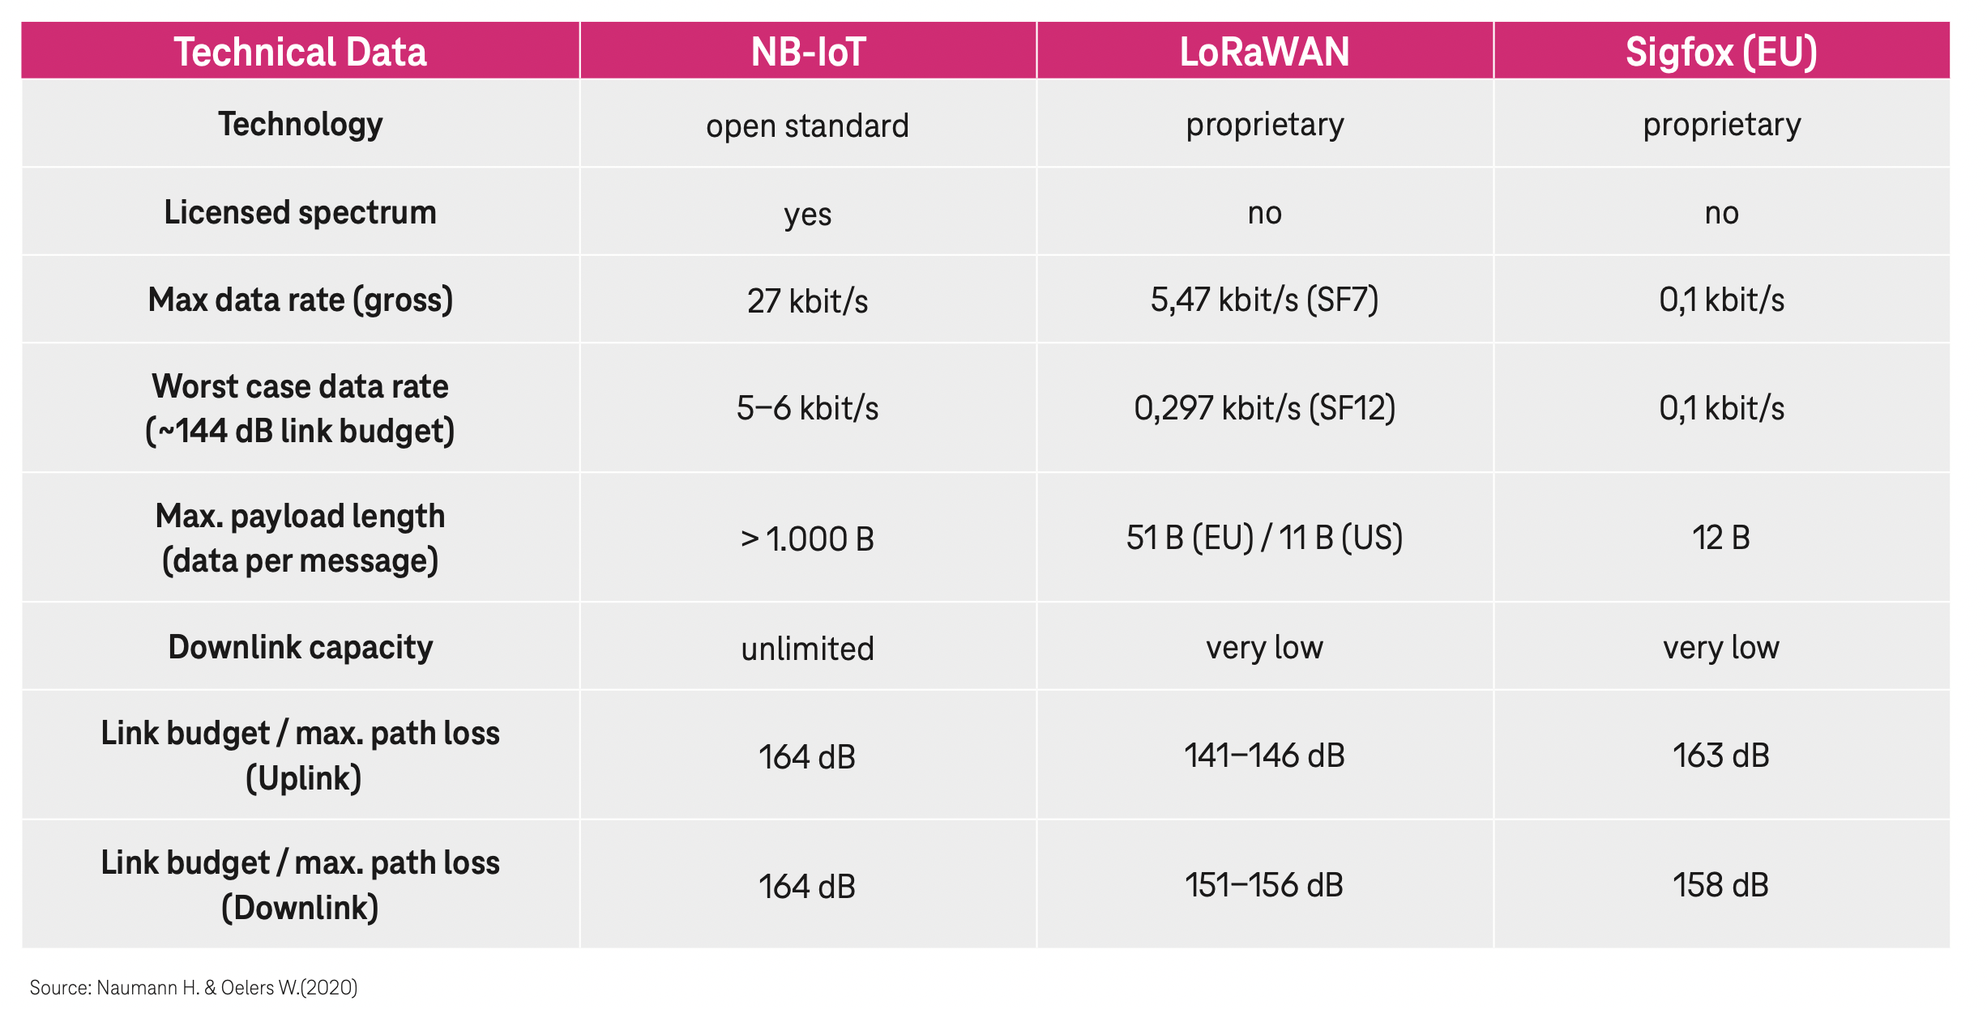
Background
LoRa vs Other LPWAN
Comparison with other LPWANs
consumes less power and lasts the battery for a long time than NB-IoT
has a higher data transmission rate than Sigfox

Slide 8
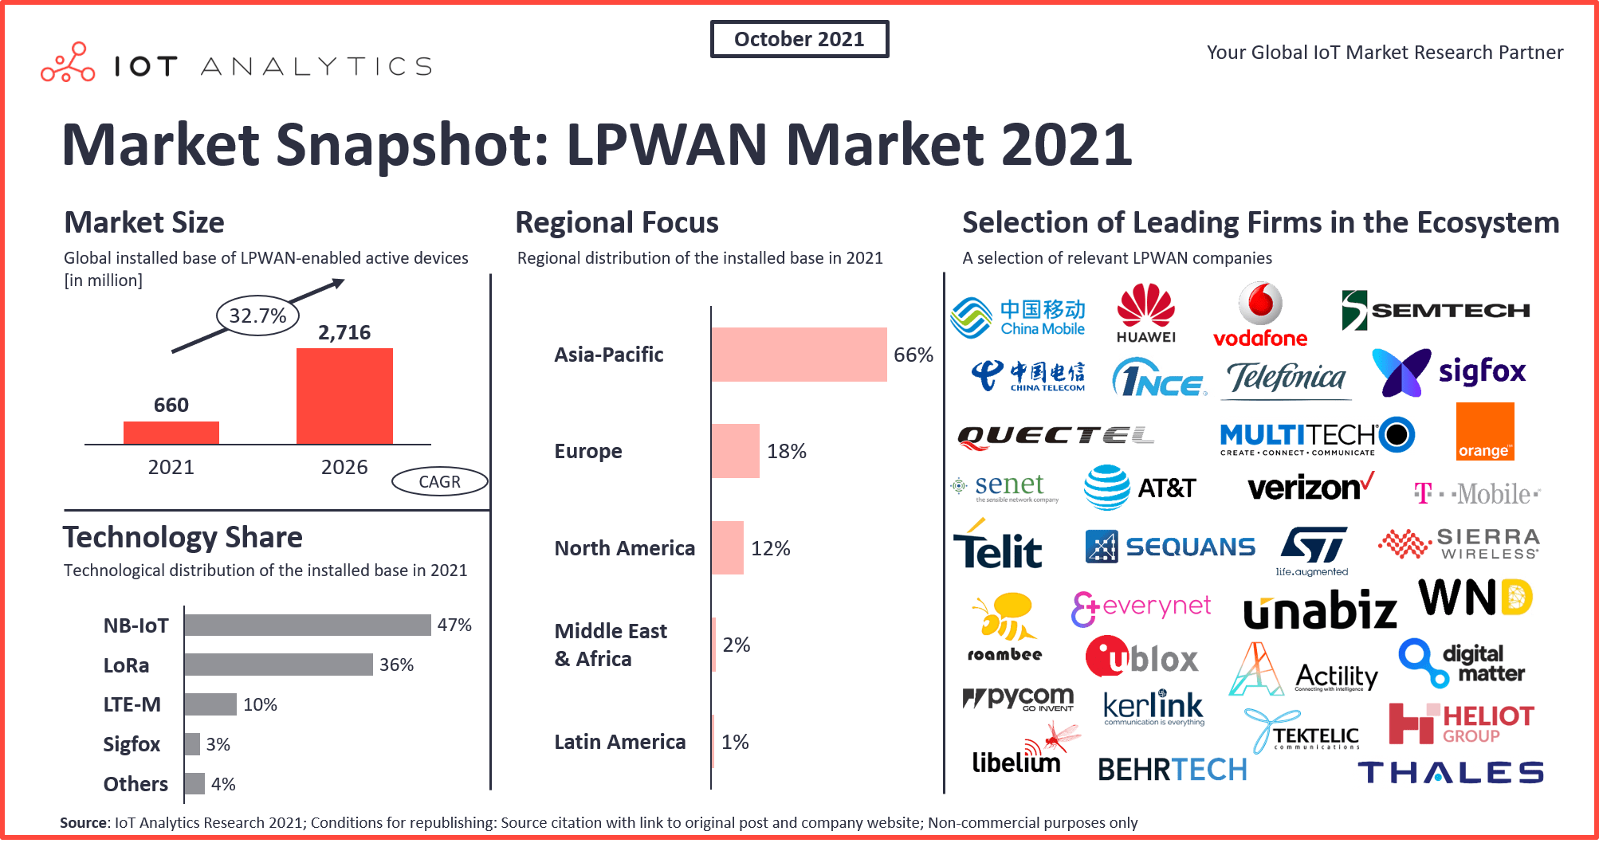
Background
Use Cases of LoRa
smart city
logistics
transportation management
smart healthcare
smart buildings
public safety
space environment
smart agriculture
Examples of current usages of LoRaWAN

Slide 9
Introduction

Slide 10

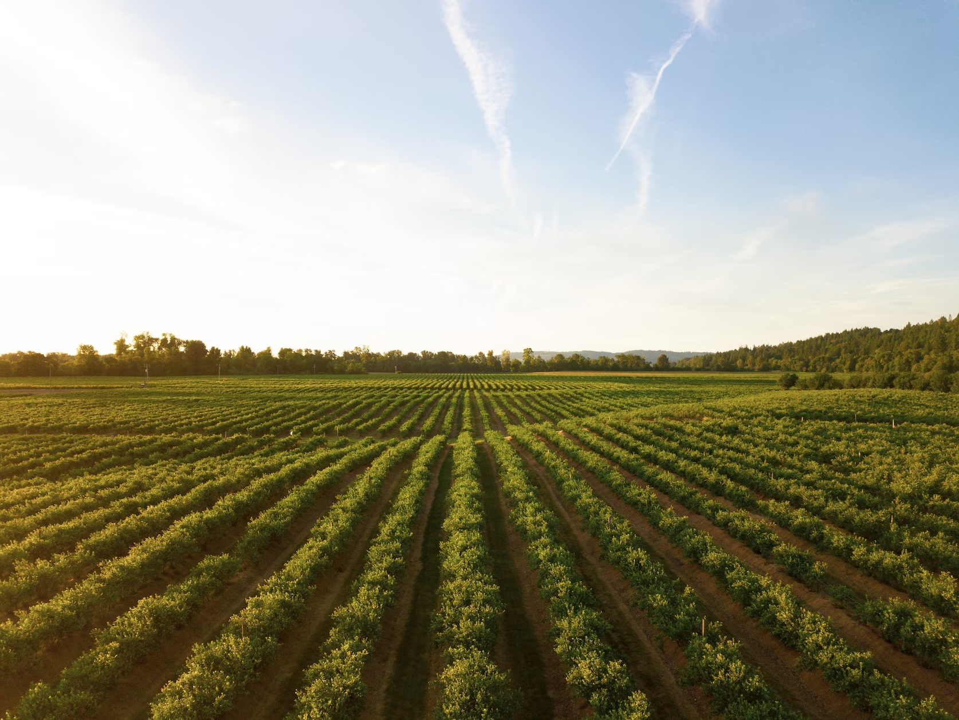
Introduction
The Risk of Hacking LoRaWAN
- Information loss can cause vital and financial damage.
Medical Area
Agriculture Area

Slide 11
Introduction
Prior Research
Replay attack
It abuses that the security keys do not change after the counter reset
ACK spoofing
It exploits that LoRaWAN does not specify the sequential number of the ACK message

Slide 12
Introduction
Prior Research
Eavesdropping
It occurs since LoRaWAN uses AES in counter-mode for encryption
​
Bit-flipping attack​
It uses the characteristic that Advanced Encryption Standard(AES) counter-mode encryption is symmetric to recover the plaintext
​

Slide 13




Introduction
Prior Research
LoRa Class B attack​
It accelerates battery exhaustion by increasing the power consumption of the sensor

Slide 14
Introduction
Goal of 454P
Demonstrating and analyzing the vulnerabilities of the LoRaWAN system
Constructing the environment with fewer external constraints that reflects real-world

Slide 15
Progress

Slide 16
Constructing Local LoRaWAN
Configuration Settings
Gateway Bridge
Raspbian OS@latest
ChirpStack v3@latest
Mosquitto@latest
Network Server & Application Server
Raspbian OS@latest
ChirpStack v3@latest
Redis: 5.0.
Mosquitto@latest
PostgreSQL: 9.5.

Slide 17
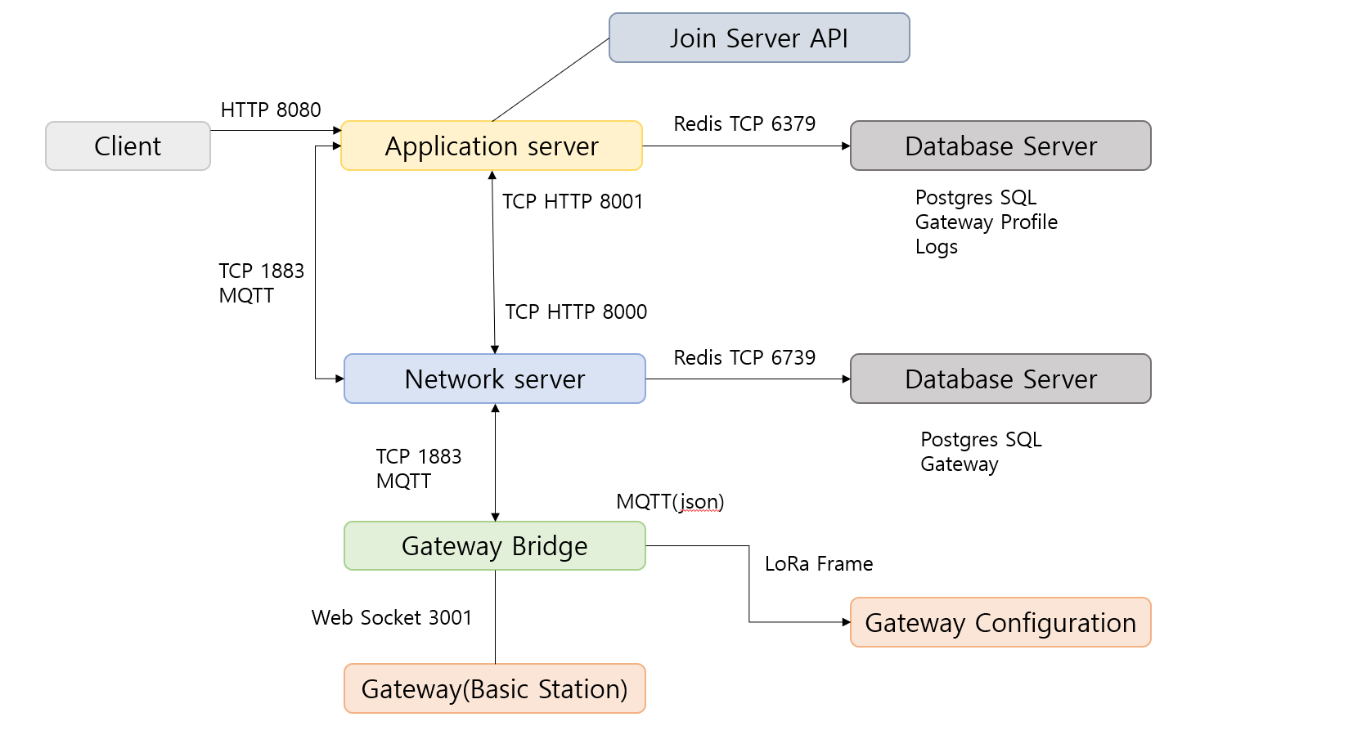
Constructing Local LoRaWAN

Slide 18
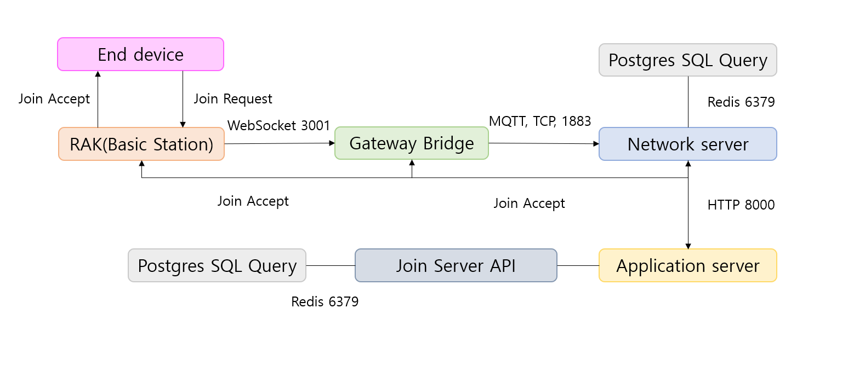
Constructing Local LoRaWAN
Join Request

Slide 19
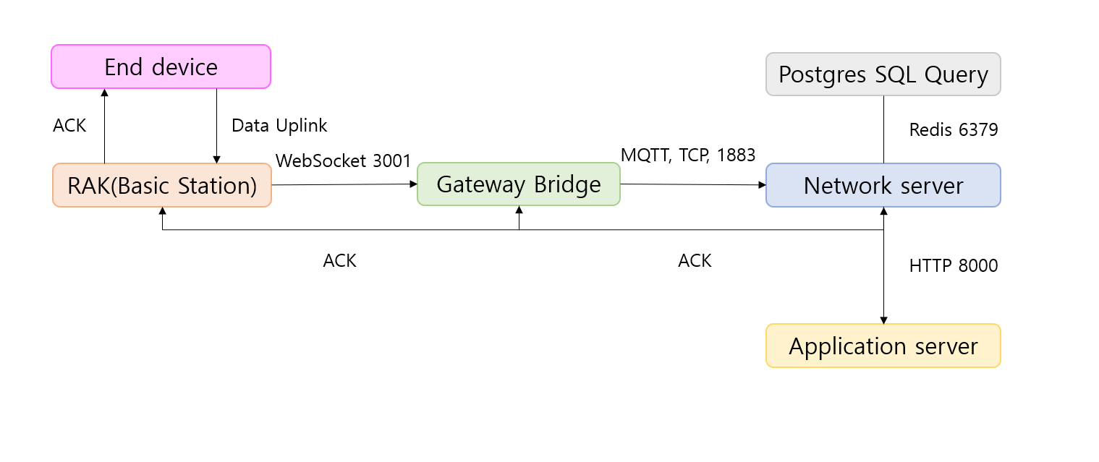
Constructing Local LoRaWAN
Data Uplink
Why local LoRaWAN?
To hack the LoRaWAN without legal issues

Slide 20
Methodology
Jamming
A technology that prevents the use of certain frequencies or radio waves
by emitting Radio Frequency
Packet transmissions using the corresponding frequency are completely blocked
Experiment details
1. Using Software Define Radio(SDR) with GNU Radio - Reactive Jamming

Slide 21
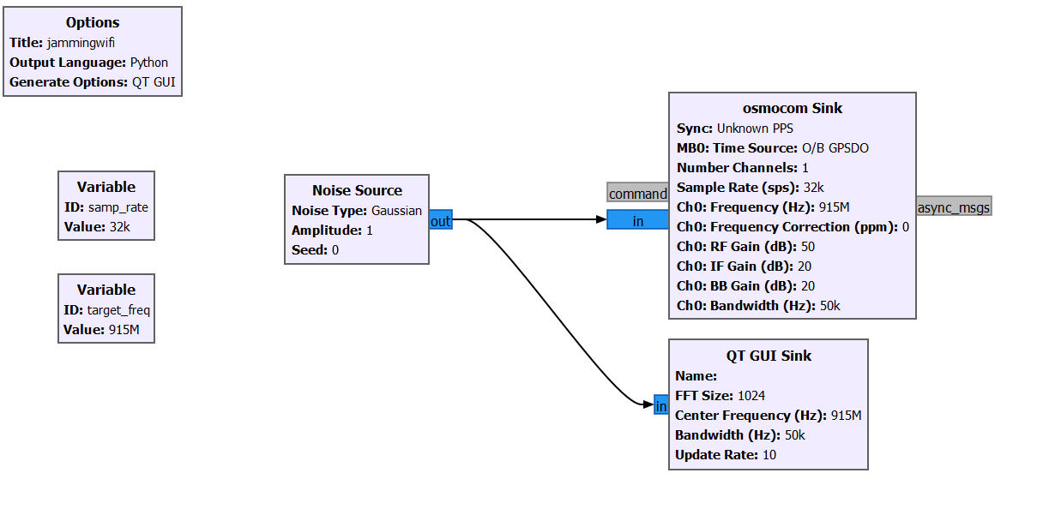
Methodology
Jamming LoRaWAN
Code blocks for jamming using SDR

Slide 22
Methodology
Jamming
A technology that prevents the use of certain frequencies or radio waves
by emitting Radio Frequency
Packet transmissions using the corresponding frequency are completely blocked
Experiment details
1. Using Software Define Radio(SDR) with GNU Radio - Reactive Jamming
2. Using Canopy devices from 20 years ago ($20 each) - Brute Force

Slide 23
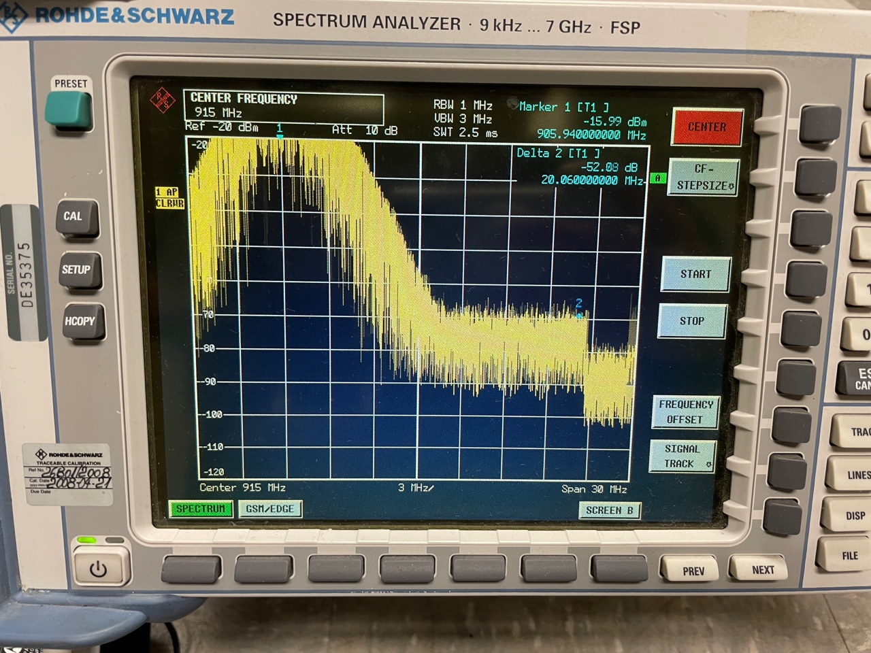
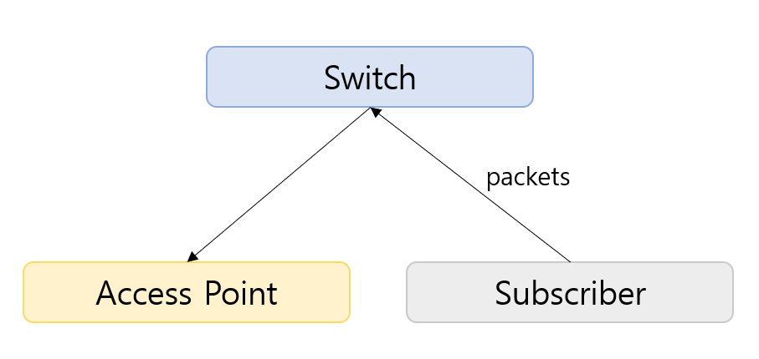
Methodology
Jamming LoRaWAN
Using Motorola Canopy
Subscriber send packets to Access Point working as a barrier

Slide 24
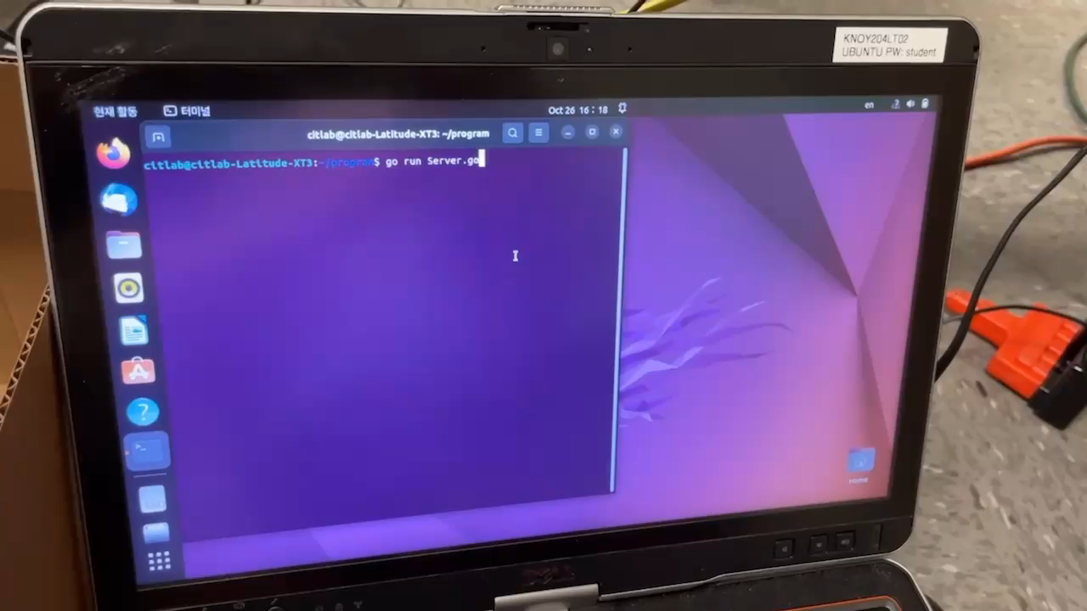
Methodology
Jamming LoRaWAN
Demo Video

Slide 25



Methodology
Sniffing
Hacker
Sensor
Sniffing
Gateway
Packet

Slide 26
Methodology
Replay Attack
Hacker
Replay Attack
Sensor
Sniffing
Gateway
Packet

Slide 27
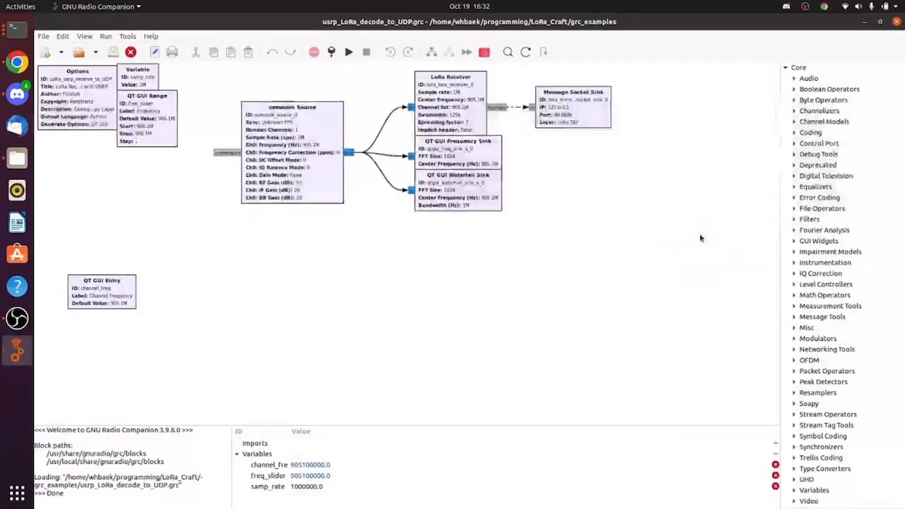
Methodology
Sniffing LoRaWAN

Slide 28
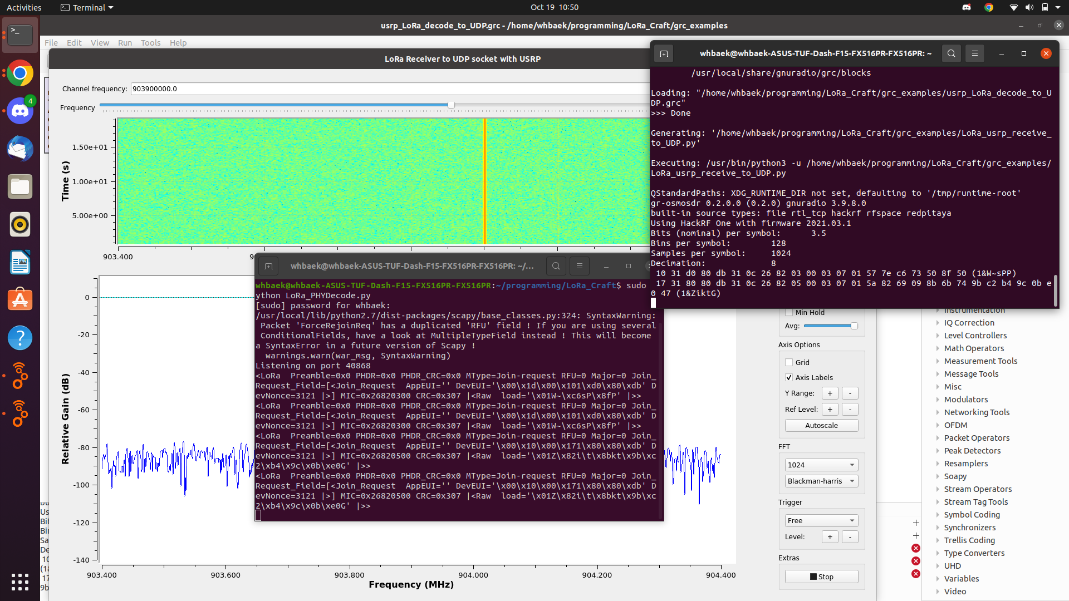
Methodology
Sniffing LoRaWAN

Slide 29
Project Milestone

Slide 30
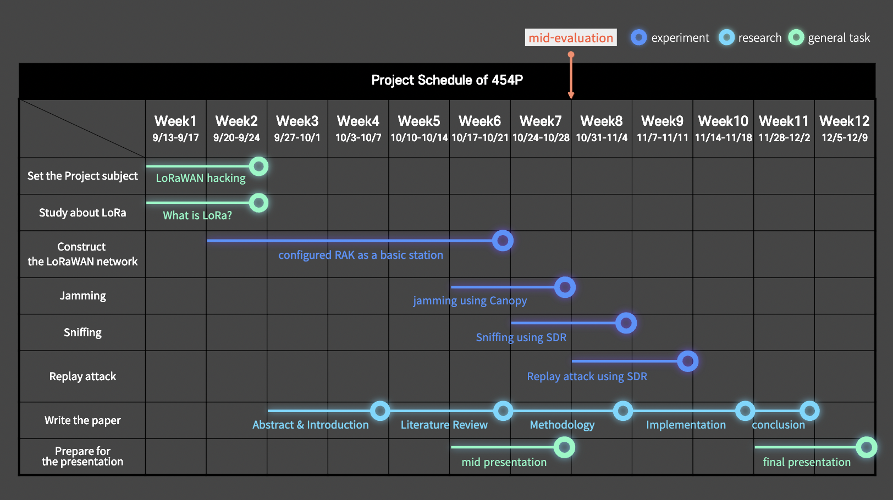
Project Milestones

Slide 31
Reference
Semtech, "What are LoRa® and LoRaWAN®,'' \url{lora-developers.semtech.com}, \url{https://lora- developers.semtech.com/documentation/tech-papers-and-guides/lora-and-lorawan} (accessed Sep. 14, 2022).
N.Blenn, F.A.Kuipers, "LoRaWAN in the Wild: Measurements from The Things Network," 2017, Blenn, Norbert and Fernando A. Kuipers. “LoRaWAN in the Wild: Measurements from The Things Network.” ArXiv abs/1706.03086 (2017): n. pag.
LoRa Alliance, "What is LoRaWAN® Specification,'' lora-alliance.org, https://lora-alliance.org/about-lorawan/(accessed Sep. 15, 2022).
F. L. Coman, K. M. Malarski, M. N. Petersen and S. Ruepp, "Security Issues in Internet of Things: Vulnerability Analysis of LoRaWAN, Sigfox and NB-IoT," 2019 Global IoT Summit (GIoTS), 2019, pp. 1-6, doi: 10.1109/GIOTS.2019.8766430.
The Things Industries, "Why you should use lora technology and LoRaWAN® for your next IOT use case,” The Things Industries, \url{https://www.thethingsindustries.com/news/why-you-should-use-lora-technology-and-lorawan-for-your-next-iot-use-case/} (accessed Oct. 10, 2022).
TEKTELIC Communications Inc., "LoRaWAN - Most Common Applications and Use Cases” iotforall.com, \url{https://www.iotforall.com/lorawan-most-common-applications-and-use-cases} (accessed Sep. 28, 2022).
X. Yang, E. Karampatzakis, C. Doerr and F. Kuipers, "Security Vulnerabilities in LoRaWAN," 2018 IEEE/ACM Third Int. Conf. on Internet-of-Things Design and Implementation (IoTDI), 2018, pp. 129-140, doi: 10.1109/IoTDI.2018.00022.
The Things Stack, “ABP vs OTAA,” The Things Stack for LoRaWAN, url{https://www.thethingsindustries.com/docs/devices/abp-vs-otaa/} (accessed Oct. 13, 2022).
IoActive, "LoRaWAN Networks Susceptible to Hacking: Common Cyber Security Problems, How to Detect and Prevent Them.", url{act-on.ioactive.com}, \url{https://act-on.ioactive.com/acton/attachment/34793/f-87b45f5f-f181-44fc-82a8-8e53c501dc4e/1/-/-/-/-/LoRaWAN\%20Networks\%20Susceptible\%20to\%20Hacking.pdf} (accessed Oct. 14, 2022).
C. -Y. Huang, C. -W. Lin, R. -G. Cheng, S. J. Yang and S. -T. Sheu, "Experimental Evaluation of Jamming Threat in LoRaWAN," 2019 IEEE 89th Vehicular Technology Conference (VTC2019-Spring), 2019, pp. 1-6, doi: 10.1109/VTCSpring.2019.8746374.
S. Tomasin, S. Zulian and L. Vangelista, "Security Analysis of LoRaWAN Join Procedure for Internet of Things Networks," 2017 IEEE Wireless Communications and Networking Conference Workshops (WCNCW), 2017, pp. 1-6, doi: 10.1109/WCNCW.2017.7919091.
S. M. Danish, A. Nasir, H. K. Qureshi, A. B. Ashfaq, S. Mumtaz and J. Rodriguez, "Network Intrusion Detection System for Jamming Attack in LoRaWAN Join Procedure," 2018 IEEE International Conference on Communications (ICC), 2018, pp. 1-6, doi: 10.1109/ICC.2018.8422721.

Slide 32
Q & A
Team 454P
2022 K-SW square mid-presentation

Slide 33
Thank you
Team 454P
2022 K-SW square mid-presentation

Slide 34
Configuring GNU Radio + LoRa Packet UDP Reader
Configuration Settings
Ubuntu: 20.04
GNU Radio 3.8/3.9
LoRa_Craft
python: 3.7.3
from python: 3.7.3 scapy@latest
GNU Radio: 3.8.5
Gr-LoRa
python: 2
from python: 2 numpy scipy
swig
cppunit
fftw
gnuradio: 3.8.5
libvolk
log4cpp
cmake
Wx
liquid-dsp
Gr-osmosdr (HackRF Connection)
libhackrf
gnuradio:3.9
HackRF one (SDR)

Slide 35
Methodology
Kracking
Nonce attack
Injection
Bit flipping

